Slide 1
Introduction of Radiographic Technology
Radiographic Terminology
Basic Imaging Principles
Positioning Principles
Digital Imaging

Slide 2
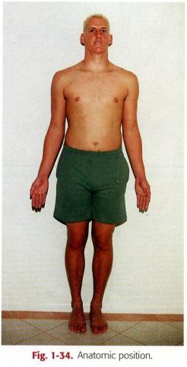
I. Radiographic Terminology
General Terms
Radiograph
Radiography
Radiograph vs. x-ray film
Radiographic images
Radiographic examination or
procedure
Anatomic position
Notes:
1.X光照片
2.X光照像術
3.Interchangably，radiograph又特指已經曝光過有影像的x光片
4.以各種形式存在可以被觀看、儲存、複製的x光影像(包含數位式)
5.包含center ray、radiation protection、exposure factor、instruction of the p’t、processing
6

Slide 3
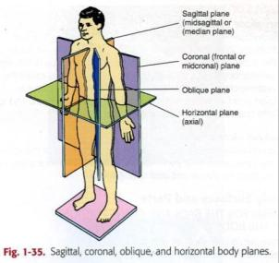
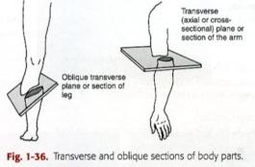
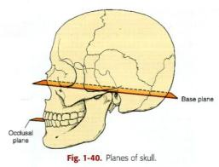
I. Radiographic Terminology
Body Plane、Section and Lines
Sagittal plane
Coronal plane
Horizontal plane
Oblique plane
Base plane
Occlusal plane
Notes:
Imaginary planes
Oblique plane：not parallel to S、C、H

Slide 4
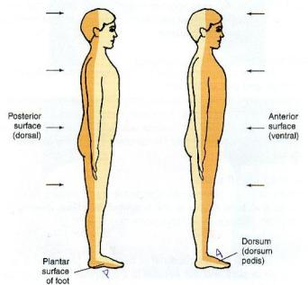
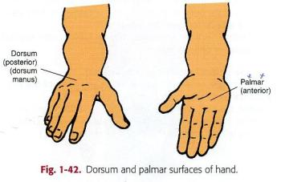
I. Radiographic Terminology
Body Surfaces and Parts
For the body
anterior
posterior
For the hands and feet
plantar
palmar
dorsum

Slide 5
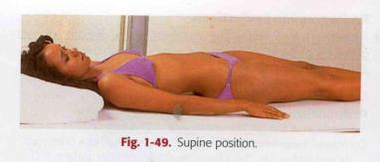
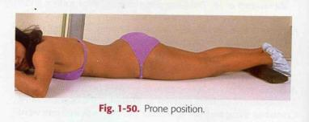
I. Radiographic Terminology
General Body Positions
Supine
Prone
Erect (stand or sit)
Recumbent
Lying down in any position
Dorsal (supine)
Ventral (prone)
Lateral

Slide 6
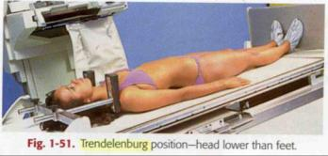
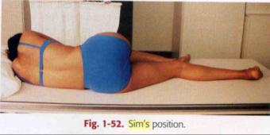
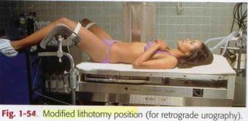
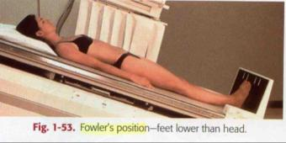
I. Radiographic Terminology
General Body Positions
Trendelenburg
Sim’s position
Fowler’s position
Lithotomy position

Slide 7
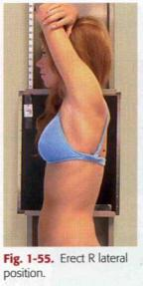
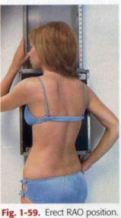
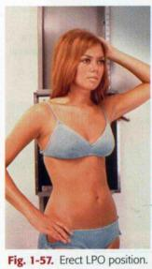
I. Radiographic Terminology
Specific Body Positions
The body part closest to the IR (oblique and lateral) or by the surface on which the patient is lying
Lateral
Right/Left
Oblique
LPO/RPO
LAO/RAO
Notes:
Used in radiography ， refer to a specific body position described by the body part closest to the film (oblique and lateral) or by the surface on which the p’t is lying (decubitus)

Slide 8
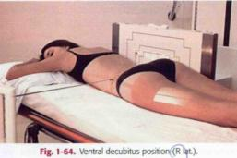
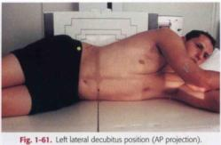
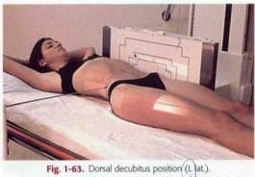
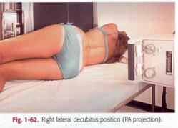
I. Radiographic Terminology
Decubitus (Lie on a horizontal surface and always used with horizontal x-ray beam)
Notes:
Recumbent就可能table有角度，CR也有角度

Slide 9
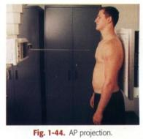
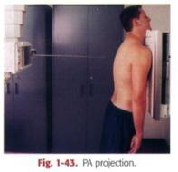
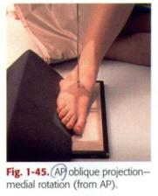
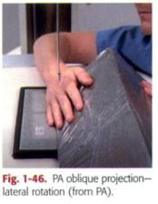
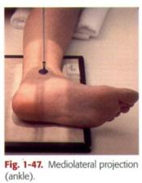
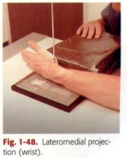
I. Radiographic Terminology
Radiographic Projection
The direction or path of the CR of the x-ray beam
Anteroposterior
Posteroanterior
AP or PA Oblique
Mediolateral or Lateromedial

Slide 10
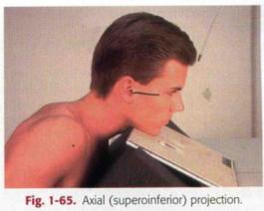
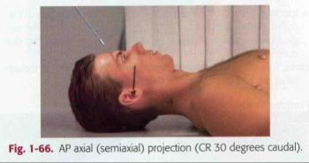
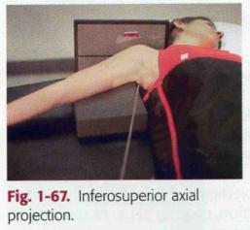
I. Radiographic Terminology
Additional Special Use Projection Terms
Axial
Superoinferior axial
Inferosuperior axial
AP/PA axial
Notes:
Axial：the long axis of the part
Special application (AP/PA axial)：describe any angle of CR more than 10 degrees along the long axis of the body

Slide 11
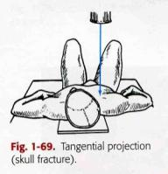
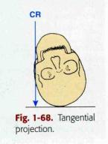
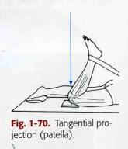
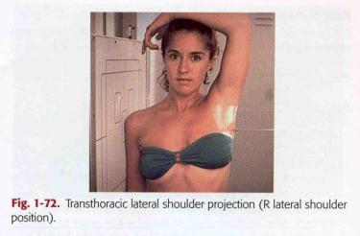
I. Radiographic Terminology
Tangential
AP axial (Lordotic)
Transthoracic lateral

Slide 12
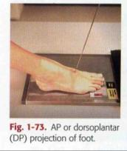
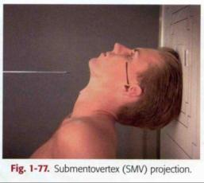
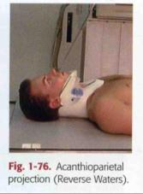
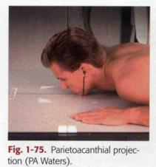
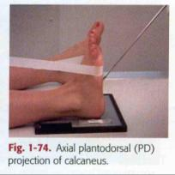
I. Radiographic Terminology
Dorsoplantar / Plantodorsal
Parietoacnthial / Acanthioparietal
Submentovertex /Verticosubmental
Notes:
SMV：IOML平行FILM。CR從兩個zygomatic arch中射入

Slide 13
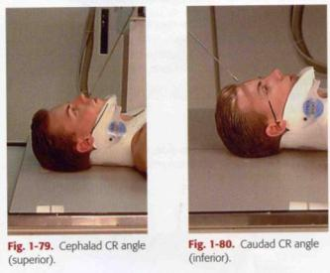
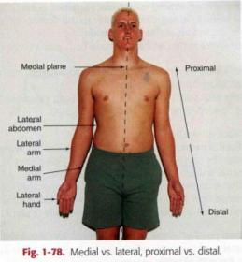
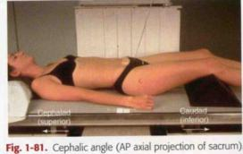
I. Radiographic Terminology
Relationship Terms
Meidal vs. Lateral
Proximal vs. Distal
Cephalad vs.Caudad

Slide 14
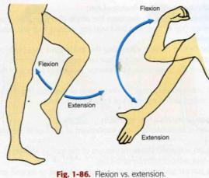
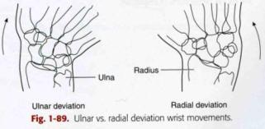
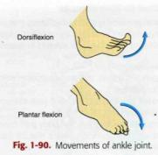
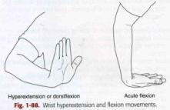
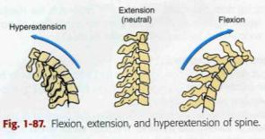
I. Radiographic Terminology
Terms Related to Movements
Flexion/Extension/Hyperextension
Ulnar deviation/Radial deviation
Dorsiflexion/Plantar flexion of foot

Slide 15
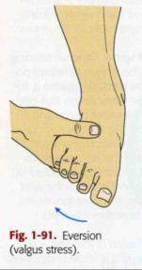
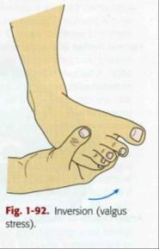
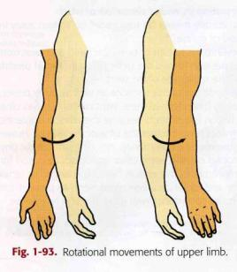
I. Radiographic Terminology
Terms Related to Movements
Eversion (Valgus)/Inversion(Varus)
Medial /Lateral Rotation

Slide 16
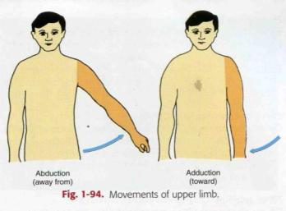
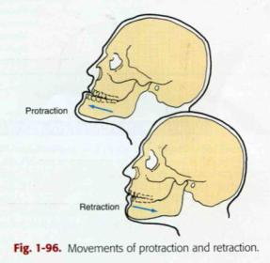
I. Radiographic Terminology
Terms Related to Movements
Abduction/Adduction
Supination/Pronation
Protraction/Retration

Slide 17
I. Radiographic Terminology
Terms Related to Movements
Elevation/Depression
Circumduction
Tilt/Rotation

Slide 18
I. Radiographic Terminology
Summary of Potentially Misused Terms
Position
restricted to the discussion of the patient’s physical position
Projection
restricted to the discussion of the path of the central ray
View
restricted to the discussion of the a radiograph or image

Slide 19
II. Basic Imaging Principles
3
Radiographic Criteria
Structures Show(1~6)
Position
Collimator and CR
Exposure Criteria
Image Markers
a
2
1
6
c
4
b
5
Notes:
Exam：forearm lateral
structure：entire radius、ulna、proximal row of carpals、elbow、distal end of humerus、soft tissue、elbow joint
position：1.long axis of the forearm aligned with long axis of IR 。2.elbow flexed 90。3.no rotation …….
collimator：borders visible at skin margins and both ends included ，CR to midpoint of radius and ulna
exposure：no rotation and optimum density (bony trabecular、sharp cortical margin….)
marker：always be included

Slide 20
II. Basic Imaging Principles
Image Markers and Patient Identification
Patient ID and Date
Anatomic side marker
Additional markers or Identification

Slide 21
II. Basic Imaging Principles
Radiographic Technique and Image Quality
Exposure factors
kVp
mA
S (excepted when AEC is used )
Image Quality Factors
Density
Contrast
Detail
Distortion

Slide 22
II. Basic Imaging Principles
Density
Definition：the amount of blackening of the processed image
Controlling factor：mAs / kVp / SID
Change rule ：Underexposure → Doubling mAs
Exception：DR and CR (controlled by image process technique)

Slide 23
II. Basic Imaging Principles
Contrast
Definition：the difference in density on adjacent areas of a radiographic image
Purpose ：make the anatomic detail of a radiographic image more visible
Controlling factor：kVp
(15% increase as mAs double)
Notes:
Low or high contrast is not necessarily good or bad by itself
High contrast (low kVp 50 mAs 800) is good for sternum (bone)
Low contrast (high kVp 110 mAs 10) is good for CXR (lung markings)

Slide 24
II. Basic Imaging Principles
Detail
Definition：the visible sharpness of structure on the image
Controlling factor
Geometric factors : focal spot size/SID/OID
Film/Screen Speed
Motion

Slide 25
II. Basic Imaging Principles
Distortion
Definition：the misrepresentation of object size or shape as projected onto film (because of beam divergence and SID)

Slide 26
II. Basic Imaging Principles
Distortion
Controlling factor
SID
OID/Focal spot size

Slide 27
II. Basic Imaging Principles
Alignment (object、film、CR)

Slide 28
II. Basic Imaging Principles
Anode Heel Effect
Intensity of cathode > anode
Pronounced at
Shorter SID
Larger IR
Small focal spot

Slide 29
III. Positioning Principles
Professional Ethics and Patient Care
CAMRT (1997.06)
Canadian Association of Medical Radiation Technologists
ASRT (1994.07)
American Society of Radiological Technologists
Protocol and Order for General Diagnostic Radiographic Procedures
Room and Exam Preparation

Slide 30
III. Positioning Principles
Positioning Method
Fixed vs. Floating tabletop
Cassette tray and Bucky grid
Beam restricting device
Illuminated adjustable collimator
Positive Beam Limitation (PBL)
Notes:
PBL
1974~1993 in U.S. and Canada , all x-ray equipment are required to include PBL (for radiation protection)

Slide 31
III. Positioning Principles
Positioning Sequences
Traditional Radiography
Step1
Step2
Step3
Step4
Notes:
Step2 is not needed when AEC is used
Step4：after part has centered to the CR，the IR is also centered to the CR (floating type tabletop)

Slide 32
Table
With bucky
no bucky
Standing bucky

Slide 33
III. Positioning Principles
Essential Projections
Routine (Basic) Projections
Commonly taken on all patients who can cooperate fully
Special (Alternate) Projections
Better demonstrate specific anatomic or certain pathology
The patients who can’t cooperate fully

Slide 34
III. Positioning Principles
Principle for Determining Positioning Routine
A minimum of two projections
Problem of anatomic structures
being superimposed
Localization of lesions or foreign bodies
Determination of alignment of fracture
A minimum of three projections
Skeletal system involving joints
AP、PA、Oblique

Slide 35
III. Positioning Principles
Topographic Positioning Landmarks
Done gently
Patient should be informed
Body Habitus

Slide 36
III. Positioning Principles
Viewing Medical Images
Radiographic Images
AP/PA/Oblique
Viewing as patient is facing the viewer
Marked by R/L

Slide 37
III. Positioning Principles
Lateral
Viewing from the same perspective as the x-ray tube
Marked R/L by the side of the patient closet to the IR
Decubitus chests and abdomen
Viewing from the same perspective as the x-ray tube
Crosswise and p’t upside on view box upside
Upper/lower limb
R/L marker appears right-side-up
Limbs hanging down
Digits up

Slide 38
III. Positioning Principles
CT or MRI Images
The patient’s right is to the viewer’s left

Slide 39
IV. Digital Imaging
PACS (Picture Archiving and Communication System)

Slide 40
IV. Digital Imaging
CR (Computed Radiography)
Key components
Image plate (repeatedly)
IP reader (laser scanner , 20s)
Workstation
Exposure factor( AEC is not used)
Compensation 500% overexposure，
80% underexposure
Positioning consideration
Center sampling technique
Accurate and close collimation
Lead masking for multiple images
Grid
Notes:
CR並沒有使用AEC，所以kVp、mA、s都是必須要手動設定。但是在CR的cassette中央位置有sensor，可以針對通過film的x-ray做出特性曲線，利用影像處理的技術將影像最佳化，當然如果一開始的條件即非常的不恰當，並沒有辦法透過這樣的方式得到好的影像品質。

Slide 41
IV. Digital Imaging
DR (Digital Radiography )
Flat panel receptor (direct conversion method )
Digital Bucky grid 17”*17”
Automatic Exposure Control (AEC)
kVp”、”m A” manual
“s” auto

Slide 42
IV. Digital Imaging
DR in CGMH
Digital image unit

Slide 43
Quality Control for Processor
Set up initial standard (base line)
In most stable condition of the processor
Individual O.D. of 21 steps (average of five days measurements)
Find O.D. ≧1.2 → Mid-density (MD) and Mid-step#
Find O.D. ≧2.2 → High-density (HD) and High-step#
Find O.D. ≧0.45 → Low-density (LD) and Low-step#
Daily QA
MD < ±0.15 (measurement - base line)
DD < ±0.15 (measurement - base line)
(DD=HD-LD)
Notes:
QA時直接把品管時測量MD、LD、HD的OD值直接與base line的相對階數OD值相減

